Slide 1
Job Simulation: OPTIMIZING SEARCH ENGINE RELEVANCE
Arun Kakani

Slide 2
Index
Introduction
Data Analysis
Distribution
Correlation plot /Heat map
Pairplots
Variable Selection
Classification Models
Comparing all Models
Recommendation
Code (GitHub link provided)
References

Slide 3
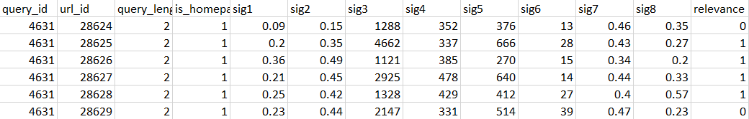
Introduction
In this presentation, I try to find a solution for optimizing search engine relevance. My technology team has given me a dataset of 80K responses, each flagged as relevant or not relevant based on extensive user testing.
The dataset also contains information about whether the response was a home page, the length of the input query and eight additional features not labelled.
Aim: classification model for optimizing relevance.

Slide 4
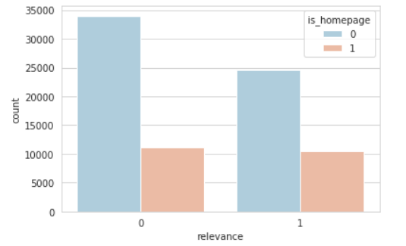
Data Analysis
Relevance
0 = not relevant
1 = relevant
Home Page
0 = not home page
1 = home page
Graph broadly indicates that when the query is not a home page, then it is more likely that it is not relevant.

Slide 5
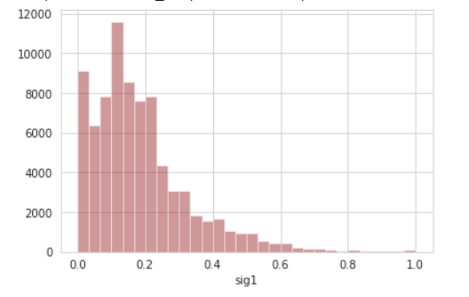
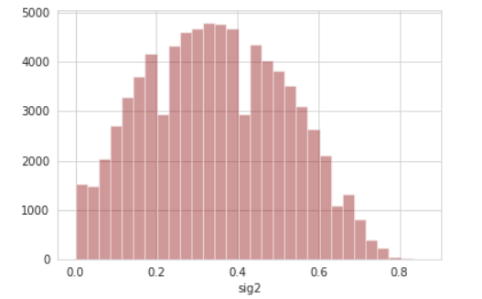
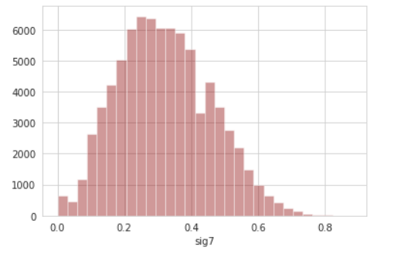
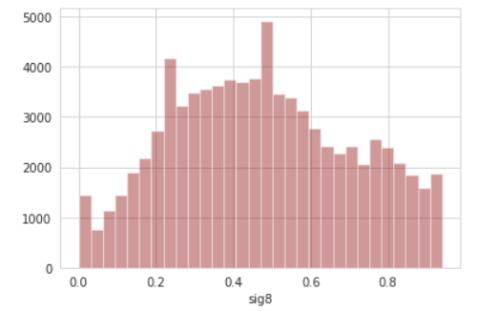
Distribution
X axis: sig values
Y axis: frequency of sig values

Slide 6
Observations about the Data
Rows = 80046
Columns = 13
Target = Relevance
No missing values
Appears to be clean data

Slide 7
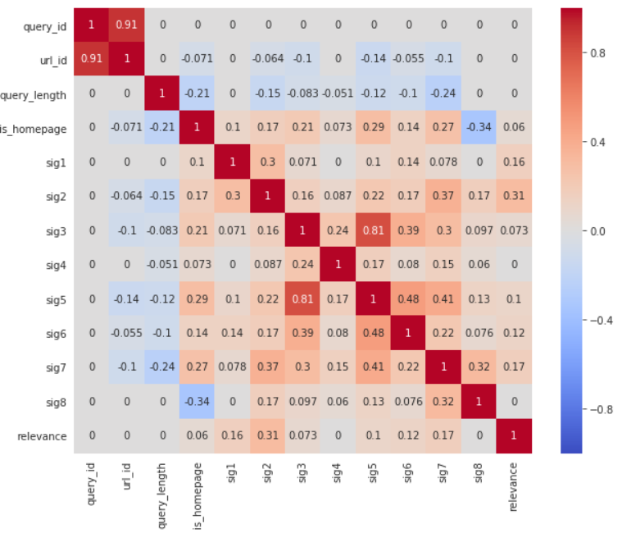
Correlation Plot/ Heat Map
This plot will help us see if there is a correlation between any of the variables which could help us for variable selection

Slide 8
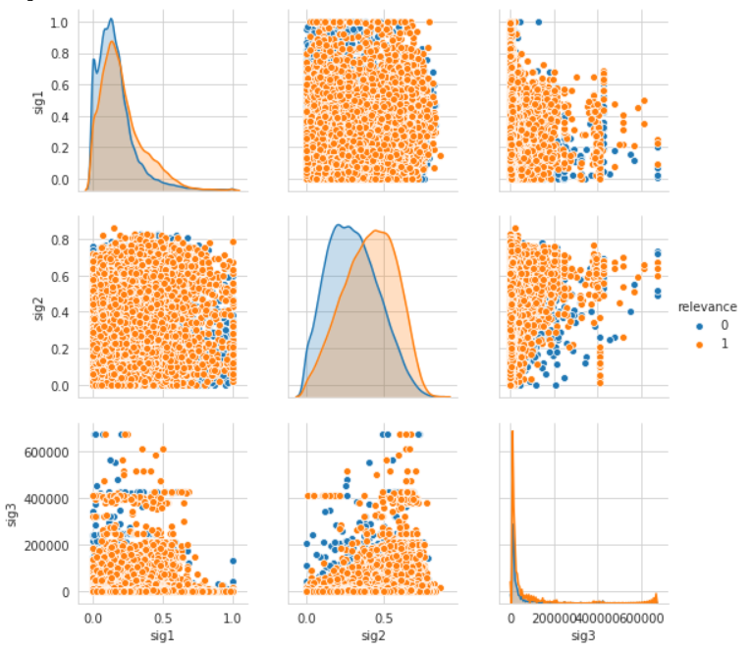
Pairplot sig1, sig2, sig3

Slide 9
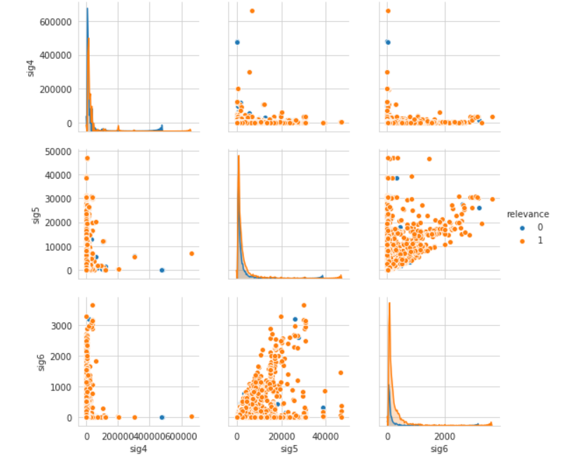
Pairplot sig4, sig5, sig6

Slide 10
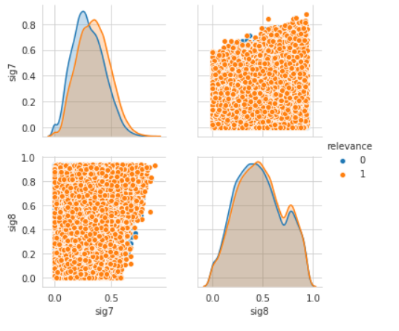
Pairplot sig7, sig8

Slide 11
Variable Selection
Forward Selection
Backward Elimination
70/30 split -- Training/Test data

Slide 12
Correlation Plot/ Heat Map

Slide 13
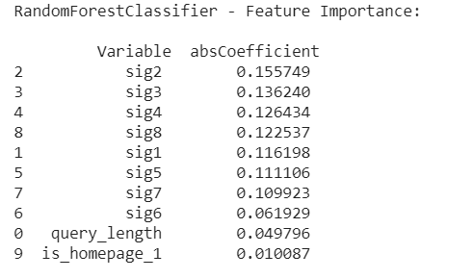
Feature Importance

Slide 14
Classification Models
The three models we are going to test on:
Logistic Regression
Random Forest
KNN
Criterion:
Accuracy
Precision
Recall
F1 Score

Slide 15
Model 1: Logistic Regression
Logistic Regression is a statistical model that uses a logistic function to model a binary dependent variable (Relevance in our case)
Less prone to overfitting
Easy to implement, interpret and efficient to train
But it assumes linearity between dependent and independent variables

Slide 16
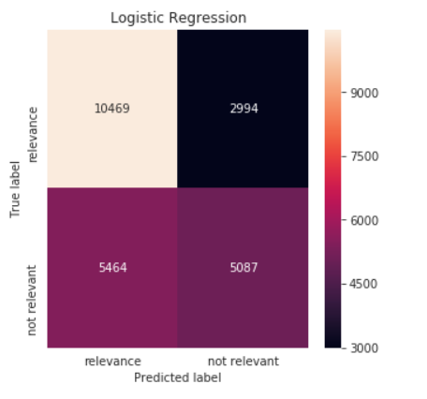
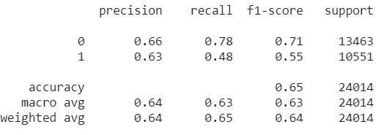
Logistic Regression Results

Slide 17
Model 2: Decision Tree
Uses decision tree as a predictive model to go from observations about an item (represented in the branches) to conclusions about the item's target value (represented in the leaves)
Simple to understand and interpret
Can handle categorical and numerical data
Can create very complex trees -- can lead to overfitting

Slide 18
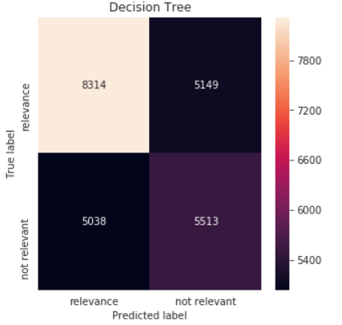
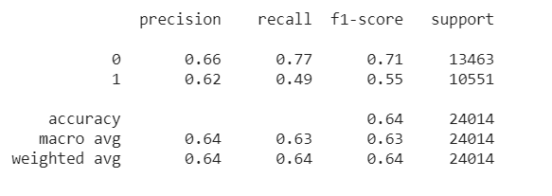
Decision Tree Results

Slide 19
Model 3: Random Forest
Random Forest algorithm grows many classification trees, where each tree gives a classification and the forest chooses the best classification
Runs well on large data bases (80k)
Very accurate compared to other algorithms

Slide 20
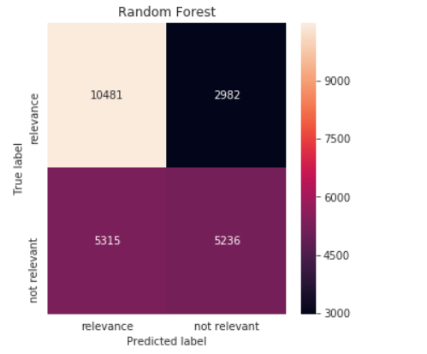
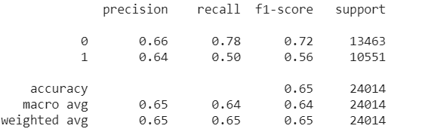
Random Forest Results

Slide 21
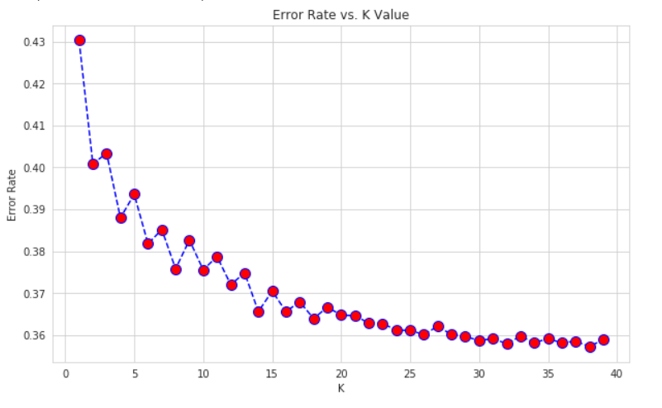
Model 4: KNN
KNN is an algorithm based on feature similarity, it is lazy algorithm
An object is classified by a majority vote of its neighbors, with the object being assigned to the class most common among its k nearest neighbors.
K = 25

Slide 22
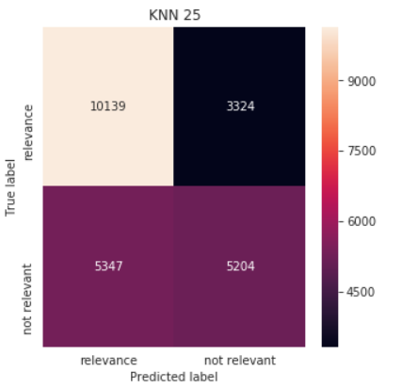
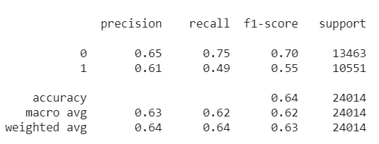
KNN Results

Slide 23
Recommendation
Random Forest
It has the highest precision, recall, f1- score and accuracy of all the models we’ve tested

Slide 24
Code
https://github.com/atkakani/OPTIMIZING-SEARCH-ENGINE-RELEVANCE/blob/master/Arun_Final_Wells_Fargo.ipynb

Slide 25
References
https://www.stat.berkeley.edu/~breiman/RandomForests/cc_home.htm
https://blog.usejournal.com/a-quick-introduction-to-k-nearest-neighbors-algorithm-62214cea29c7
https://en.wikipedia.org/wiki/Logistic_regression
https://en.wikipedia.org/wiki/Decision_tree_learning

